Slide 1

Theories of Child Personality Development:
Freud Theory of Psychosexual
Third Stage
Dr. Moustafa Alshammari
Growth and Developments

Slide 2

O B J E C T I V E S
After mastering the contents of this lecture, you should be able to:
1
Identify the major concepts of selected theories of development.
Compare the major points of view related to the formulation of selected developmental theories.
Assess the relevance of selected theories of development to nursing care of children, adults, and old age.
2
3

Slide 3
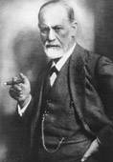
Sigmund Freud
Sigmund Freud was born May 6, 1856
Died September 23, 1939

Slide 4
Freud's Motivational theory of Personality
Sigmund Freud introduced a number of concepts about development that are still recognized today.

Slide 5
Freud’s concepts about development
The unconscious mind: is the mental life of a person of which the person is unaware. This concept of the unconscious is one of Freud's major contributions to the field of psychiatry.
Defense mechanisms / adaptive mechanisms: as they are more commonly called today, are the result of conflicts between inner impulses and the anxiety that attends these conflicts.
(continued)

Slide 6
Freud’s concepts about development
The Id: Is the source of instinctive غريزية and unconscious urges, and also the source of all pleasure and gratification.
*The ego: الأنا is formed by the person to make effective contact with social and physical needs. Through the ego, the id impulses are satisfied. The ego seeks pleasure and avoids pain in rational way that society approves.
(continued)

Slide 7
Freud’s concepts about development
The Superego:الأنا العليا This is conscience of the personality, a control on the id. The superego reminds the person of what would be ideal behaviors and what behaviors are totally unacceptable. The superego is the source of feeling of guilt, shame, and inhibition.

Slide 8
Personality development
Freud proposed that the development of personality advanced through several psychosexual stages.
In each of these stages, the libidinal energy found a particular focus if the individual progressed through each stage without serious difficulties.
(continued)

Slide 9
Personality development
Disturbances in the form of frustration or excessive gratification during one of the stages could lead to fixation at that stage, meaning that some of the libidinal energy of the adult would have to be used to satisfy responding appropriately to that stage rather than responding appropriate for an adult.

Slide 10
Freud Psychosexual Stages of Development
The Oral Stage (0 – 12 months)
The Anal Stage (1 – 3 years)
The Phallic Stage (3 – 6 years)
The period of Latency (6 – 12 years)
The Adolescence and adulthood {Genital Stage} (12+ years)

Slide 11
The Oral Stage (0 – 12 month)
The first psychosexual stage. This stage lasts from birth to the first year of life. Libidinal energy centers on oral activities, particularly feeding and weaning.
Mouth is the center of pleasure.
(continued)

Slide 12
The Oral Stage (0 – 12 month)
Fixation at this stage means that a high level of oral activity may be shown by the adult.
E.g. Fixation at the oral stage may be represented by activities such as excessive gum-chewing, fingernail butting, talking, or eating.
These behaviors are thought to occur because the person either has been satisfied too much during the oral stage or because the person has not had enough satisfaction during the stage.

Slide 13
The Anal Stage (1 – 3 years)
The anal stage is the second psychosexual stage. Anus and rectum are the centers of pleasure. This stage occurs during toilet training.
Fixation at the anal stage may result in adult difficulties with the given obsessive compulsive personality traits, such as obstinacy, stinginess, cruelty, temper and conflicts between neatness and sloppiness.

Slide 14
The Phallic Stage (3 – 6 years)
In this stage, the source of libidinal pleasure is in the genitalia. Characteristic behavior at this time include exploration of genitals, infantile masturbation, and interest in the anatomical differences between the sexes.
Inability to achieve adult sexuality and responsiveness may result from fixation at this stage.
Freud believed this was the period when what he called the Oedipal complex (for boys) and the Electra complex (for girls) had to be resolved.

Slide 15
The Phallic Stage (3 – 6 years)
Freud proposed that a child has sexual desires for the parent of the opposite sex and feels competition with the parent of the same sex. However, fear of punishment causes the child to identify with the parent of the same sex and to adopt similar behaviors.
According to Freud, failure to complete this identification process may result in incomplete gender identity, difficulties in authority situation, or homosexuality

Slide 16
The period of Latency (6 – 12 years)
At the end of the phallic stage about the age of 5 or 6 years, Freud believed the child entered a latency stage.
Which means the psychosexual concerns no longer existed.
During this period, libidinal energies are reduced dramatically

Slide 17
The Adolescence and adulthood {Genital Stage} (12 years >
With the onset of puberty, a person goes into the final stage of development. At this point, the libidinal energies are rearoused, and the individual attempts to achieve adult sexuality.
If there have been difficulties at earlier stage, the giving and receiving of adult mature love may be difficult or impossible to achieve.

Slide 18
The Adolescence and adulthood {Genital Stage} (12 years >
Example:
Suppose a person experiences considerable frustration during the period of toilet training. It is possible that the residual fixation may cause the person to be stingy, stubborn, or extremely fussy. All such characteristics might prevail against the mature expression of giving and receiving love.

Slide 19
Ego Defense Mechanisms
Freud proposed that actions or events that insult the superego and damage to one's self-image result in anxiety in the ego.
To keep this damage and anxiety to a minimum, a person develops and uses ego defense mechanisms as a way of protecting the self.

Slide 20
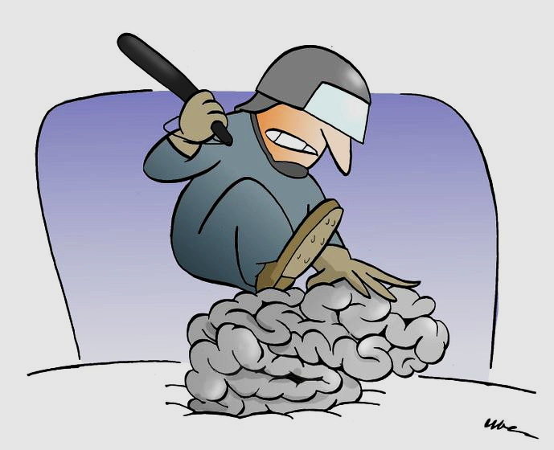
Repression
It is the first step in all defense mechanisms and the most prevalent.
Sustained repression requires psychic energy (anxiety) This may result in an abnormal personality pattern
It is well-known defense mechanism. Repression acts to keep information out of conscious awareness. However, these memories don't just disappear; they continue to influence our behavior. For example, a person who has repressed memories of abuse suffered as a child may later have difficulty forming relationships

Slide 21

Sublimation
It is a defense mechanism that allows us to act out unacceptable impulses by converting these behaviors into a more acceptable form. For example, a person experiencing extreme anger might take up kick-boxing as a means of venting frustration. Freud believed that sublimation was a sign of maturity that allows people to function normally in socially acceptable ways.

Slide 22

Rationalization
The most common defense mechanisms after regression
A person who acts for a reason that is considered unacceptable may account for that action by claiming it was done for some other, acceptable reason

Slide 23
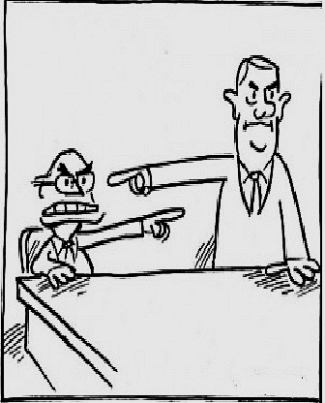
Projection
People who attribute their unacceptable feelings to others
Projection may allow the person to express sentiments or beliefs that would produce anxiety if they were accepted as his or her own
For example, if you have a strong dislike for someone, you might instead believe that he or she does not like you

Slide 24

Displacement
Displacement occurs when aggressive reactions are directed toward some ‘’ innocent stimulus rather than the one producing anger’’
express our anger towards a person or object that poses no threat (such as our spouse, children or pets).
This is done because direct attack upon the hostility producing stimulus is viewed as too stressful, and yet relief is desired

Slide 25
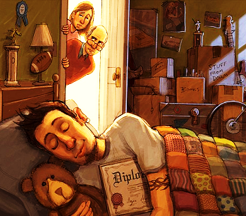
Regression
A person who adopts an attitude that is appropriate to a younger age level may be showing regression
Adopting a more childlike attitude may allow the person to avoid responsibilities and not lose face
(continued)

Slide 26
Regression
When confronted by stressful events, people sometimes abandon coping strategies and revert to patterns of behavior used earlier in development. Anna Freud called this defense mechanism regression, suggesting that people act out behaviors from the stage of psychosexual development in which they are fixated.
For example, an individual fixated at an earlier developmental stage might cry or sulk نكدupon hearing unpleasant news.
(continued)

Slide 27
Regression
Behaviors associated with regression can vary greatly depending upon which stage the person is fixated at:
An individual fixated at the oral stage might begin eating or smoking excessively, or might become very verbally aggressive.
A fixation at the anal stage might result in excessive tidiness or messiness.

Slide 28
Thank you

